Slide 1
Indexing, Hashing and Transaction

Slide 2
Basic Concepts
Indexing mechanisms used to speed up access to desired data.
  E.g., author catalog in library
Search Key - attribute to set of attributes used to look up records in a file.
An index file consists of records (called index entries) of the form
Index files are typically much smaller than the original file
Two basic kinds of indices:
  Ordered indices: search keys are stored in sorted order
  Hash indices: search keys are distributed uniformly across “buckets” using a “hash function”.
search-key
pointer

Slide 3
Index Evaluation Metrics
Access types supported efficiently. E.g.,
  records with a specified value in the attribute
  or records with an attribute value falling in a specified range of values.
Access time
Insertion time
Deletion time
Space overhead

Slide 4
Ordered Indices
Indexing techniques evaluated on basis of:
In an ordered index, index entries are stored sorted on the search key value. E.g., author catalog in library.
Primary index: in a sequentially ordered file, the index whose search key specifies the sequential order of the file.
  Also called clustering index
  The search key of a primary index is usually but not necessarily the primary key.
Secondary index: an index whose search key specifies an order different from the sequential order of the file. Also called
non-clustering index.
Index-sequential file: ordered sequential file with a primary index.

Slide 5
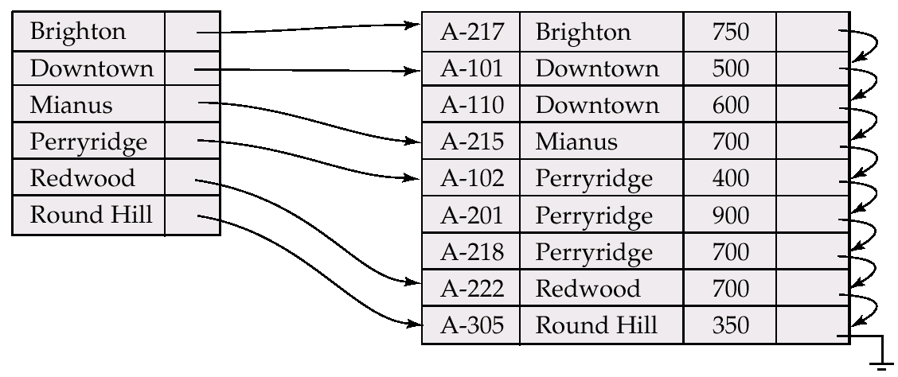
Dense Index Files
Dense index — Index record appears for every search-key value in the file.

Slide 6
Sparse Index Files
Sparse Index: contains index records for only some search-key values.
  Applicable when records are sequentially ordered on search-key
To locate a record with search-key value K we:
  Find index record with largest search-key value < K
  Search file sequentially starting at the record to which the index record points
Less space and less maintenance overhead for insertions and deletions.
Generally slower than dense index for locating records.
Good tradeoff: sparse index with an index entry for every block in file, corresponding to least search-key value in the block.

Slide 7
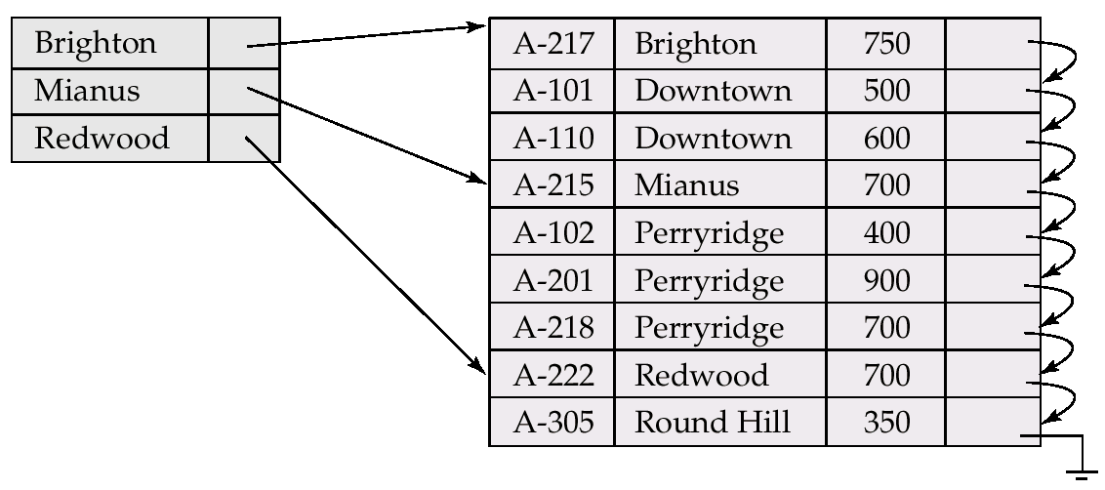
Example of Sparse Index Files

Slide 8
Multilevel Index
If primary index does not fit in memory, access becomes expensive.
To reduce number of disk accesses to index records, treat primary index kept on disk as a sequential file and construct a sparse index on it.
  outer index – a sparse index of primary index
  inner index – the primary index file
If even outer index is too large to fit in main memory, yet another level of index can be created, and so on.
Indices at all levels must be updated on insertion or deletion from the file.

Slide 9
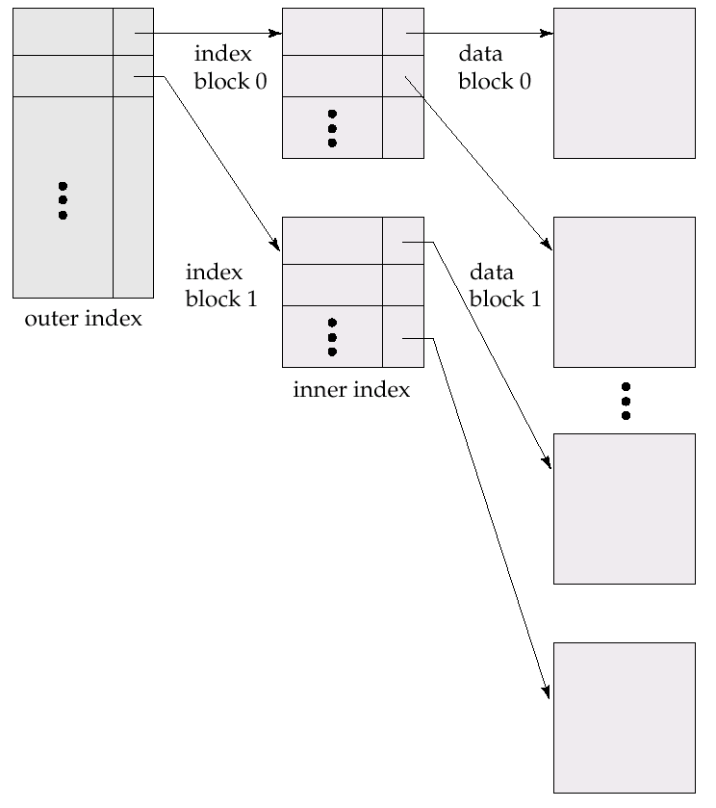
Multilevel Index (Cont.)

Slide 10
Primary and Secondary Indices
Secondary indices have to be dense.
Indices offer substantial benefits when searching for records.
When a file is modified, every index on the file must be updated, Updating indices imposes overhead on database modification.
Sequential scan using primary index is efficient, but a sequential scan using a secondary index is expensive
  each record access may fetch a new block from disk

Slide 11
Static Hashing
A bucket is a unit of storage containing one or more records (a bucket is typically a disk block).
In a hash file organization we obtain the bucket of a record directly from its search-key value using a hash function.
Hash function h is a function from the set of all search-key values K to the set of all bucket addresses B.
Hash function is used to locate records for access, insertion as well as deletion.
Records with different search-key values may be mapped to the same bucket; thus entire bucket has to be searched sequentially to locate a record.

Slide 12
Example of Hash File Organization (Cont.)
Hash file organization of account file, using branch-name as key
(See figure in next slide.)
There are 10 buckets,
The binary representation of the ith character is assumed to be the integer i.
The hash function returns the sum of the binary representations of the characters modulo 10
  E.g. h(Perryridge) = 5 h(Round Hill) = 3 h(Brighton) = 3 where A=1, B=2, C=3,D=4 etc.

Slide 13
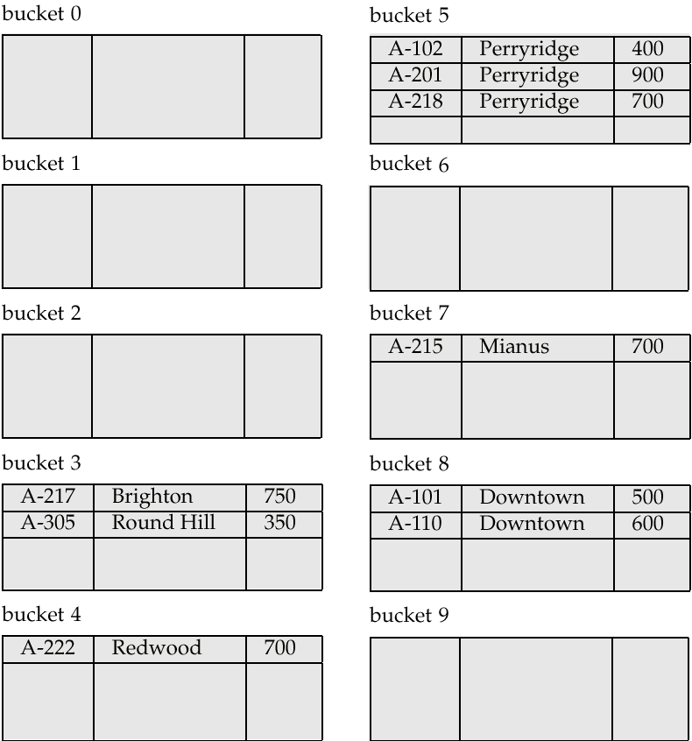
Example of Hash File Organization
Hash file organization of account file, using branch-name as key
(see previous slide for details).

Slide 14
Hash Functions
Worst has function maps all search-key values to the same bucket; this makes access time proportional to the number of search-key values in the file.
An ideal hash function is uniform, i.e., each bucket is assigned the same number of search-key values from the set of all possible values.
Ideal hash function is random, so each bucket will have the same number of records assigned to it irrespective of the actual distribution of search-key values in the file.The hash value will not be correlated to any externally visible ordering on the search-key values such as alphabetic ordering or ordering by the length of the search keys, the hash function will appear to be random.
Typical hash functions perform computation on the internal binary representation of the search-key.
  For example, for a string search-key, the binary representations of all the characters in the string could be added and the sum modulo the number of buckets could be returned. .

Slide 15
Handling of Bucket Overflows
Bucket overflow can occur because of
  Insufficient buckets
  Skew in distribution of records. This can occur due to two reasons:
    multiple records have same search-key value
    chosen hash function produces non-uniform distribution of key values
Although the probability of bucket overflow can be reduced, it cannot be eliminated; it is handled by using overflow buckets.

Slide 16
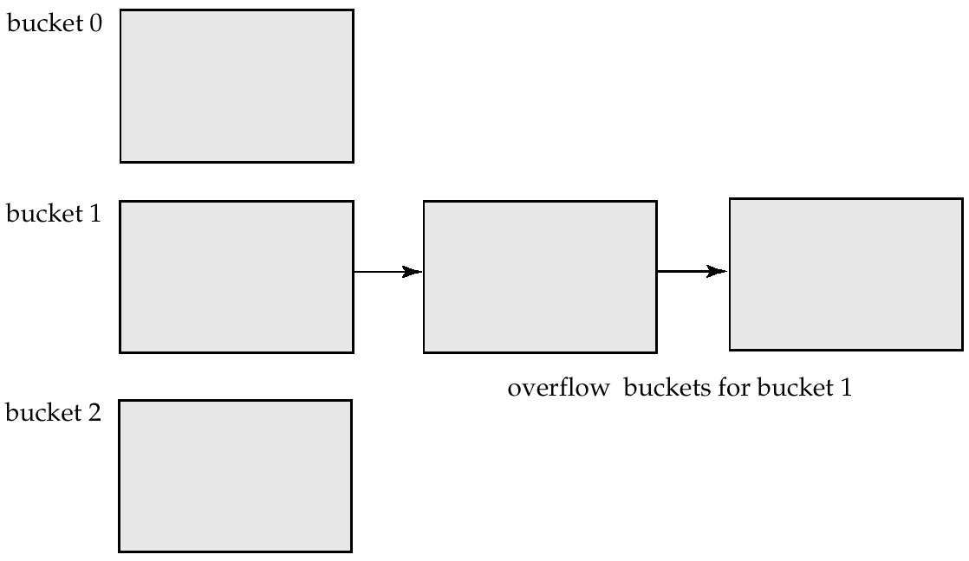
Handling of Bucket Overflows (Cont.)
Overflow chaining – the overflow buckets of a given bucket are chained together in a linked list.
Above scheme is called closed hashing.
  An alternative, called open hashing, which does not use overflow buckets, is not suitable for database applications.

Slide 17
Hash Indices
Hashing can be used not only for file organization, but also for index-structure creation.
A hash index organizes the search keys, with their associated record pointers, into a hash file structure.
Strictly speaking, hash indices are always secondary indices
  if the file itself is organized using hashing, a separate primary hash index on it using the same search-key is unnecessary.
  However, we use the term hash index to refer to both secondary index structures and hash organized files.

Slide 18
Transaction Concept
A transaction is a unit of program execution that accesses and possibly updates various data items.
A transaction must see a consistent database.
During transaction execution the database may be inconsistent.
When the transaction is committed, the database must be consistent.
Two main issues to deal with:
  Failures of various kinds, such as hardware failures and system crashes
  Concurrent execution of multiple transactions

Slide 19
ACID Properties
To preserve integrity of data, the database system must ensure:
Atomicity. Either all operations of the transaction are properly reflected in the database or none are.
Consistency. Execution of a transaction in isolation preserves the consistency of the database.
Isolation. Although multiple transactions may execute concurrently, each transaction must be unaware of other concurrently executing transactions. Intermediate transaction results must be hidden from other concurrently executed transactions.
  That is, for every pair of transactions T_{i} and T_{j}, it appears to T_{i} that either T_{j}, finished execution before T_{i} started, or T_{j} started execution after T_{i} finished.
Durability. After a transaction completes successfully, the changes it has made to the database persist, even if there are system failures.

Slide 20
Example of Fund Transfer
Transaction to transfer $50 from account A to account B:
  1. read(A)
  2. A := A – 50
  3. write(A)
  4. read(B)
  5. B := B + 50
  6. write(B)
Consistency requirement – the sum of A and B is unchanged by the execution of the transaction.
Atomicity requirement — if the transaction fails after step 3 and before step 6, the system should ensure that its updates are not reflected in the database, else an inconsistency will result.

Slide 21
Example of Fund Transfer (Cont.)
Durability requirement — once the user has been notified that the transaction has completed (i.e., the transfer of the $50 has taken place), the updates to the database by the transaction must persist despite failures.
Isolation requirement — if between steps 3 and 6, another transaction is allowed to access the partially updated database, it will see an inconsistent database
(the sum A + B will be less than it should be).
Can be ensured trivially by running transactions serially, that is one after the other. However, executing multiple transactions concurrently has significant benefits, as we will see.

Slide 22
Transaction State
Active, the initial state; the transaction stays in this state while it is executing
Partially committed, after the final statement has been executed.
Failed, after the discovery that normal execution can no longer proceed.
Aborted, after the transaction has been rolled back and the database restored to its state prior to the start of the transaction. Two options after it has been aborted:
  restart the transaction – only if no internal logical error
  kill the transaction
Committed, after successful completion.

Slide 23

Transaction State (Cont.)

Slide 24
Implementation of Atomicity and Durability
The recovery-management component of a database system implements the support for atomicity and durability.
The shadow-database scheme:
  assume that only one transaction is active at a time.
  a pointer called db_pointer always points to the current consistent copy of the database.
  all updates are made on a shadow copy of the database, and db_pointer is made to point to the updated shadow copy only after the transaction reaches partial commit and all updated pages have been flushed to disk.
  in case transaction fails, old consistent copy pointed to by db_pointer can be used, and the shadow copy can be deleted.

Slide 25
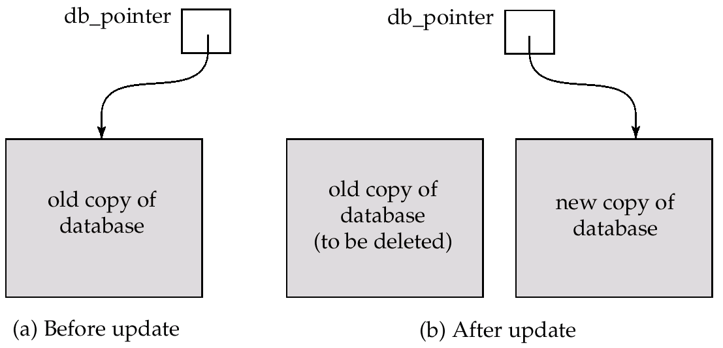
Implementation of Atomicity and Durability (Cont.)
The shadow-database scheme:
Assumes disks to not fail
Useful for text editors, but extremely inefficient for large databases: executing a single transaction requires copying the entire database. Will see better schemes in Chapter 17.

Slide 26
Concurrent Executions
Multiple transactions are allowed to run concurrently in the system. Advantages are:
  increased processor and disk utilization, leading to better transaction throughput: one transaction can be using the CPU while another is reading from or writing to the disk
  reduced average response time for transactions: short transactions need not wait behind long ones.
Concurrency control schemes – mechanisms to achieve isolation, i.e., to control the interaction among the concurrent transactions in order to prevent them from destroying the consistency of the database
  Will study in Chapter 14, after studying notion of correctness of concurrent executions.

Slide 27
Schedules
Schedules – sequences that indicate the chronological order in which instructions of concurrent transactions are executed
  a schedule for a set of transactions must consist of all instructions of those transactions
  must preserve the order in which the instructions appear in each individual transaction.

Slide 28

Example Schedules
Let T₁ transfer $50 from A to B, and T₂ transfer 10% of the balance from A to B. The following is a serial schedule (Schedule 1 in the text), in which T₁ is followed by T₂.

Slide 29

Example Schedule (Cont.)
Let T₁ and T₂ be the transactions defined previously. The following schedule (Schedule 3 in the text) is not a serial schedule, but it is equivalent to Schedule 1.
In both Schedule 1 and 3, the sum A + B is preserved.

Slide 30

Example Schedules (Cont.)
The following concurrent schedule (Schedule 4 in the text) does not preserve the value of the the sum A + B.

